Slide 1
20ITE03-USER INTERFACE DESIGN Title : EB BILL AND USER BILL MANGEMENT
Submitted by,
KAYETHRI D-20ITR051
LIVITHASRI J-20ITR056

Slide 2
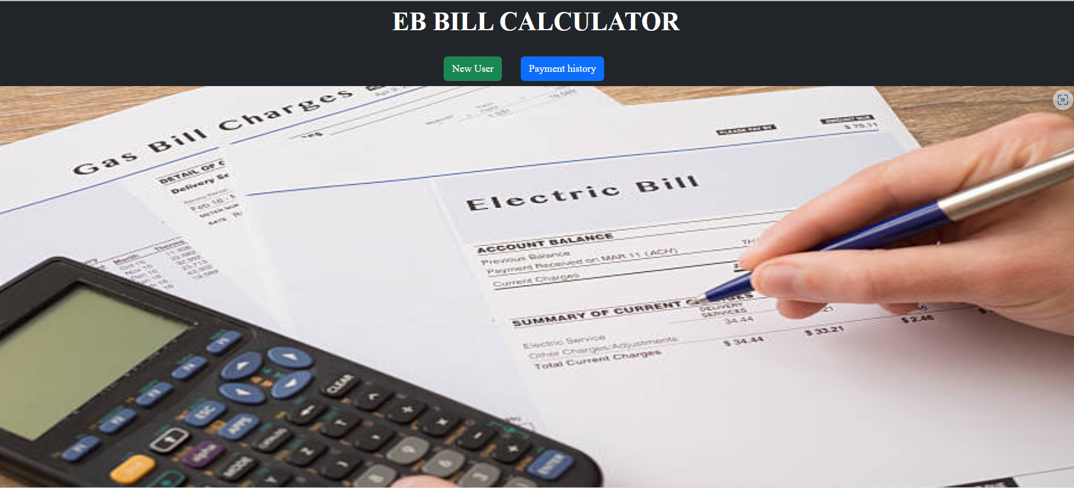
HOME PAGE

Slide 3
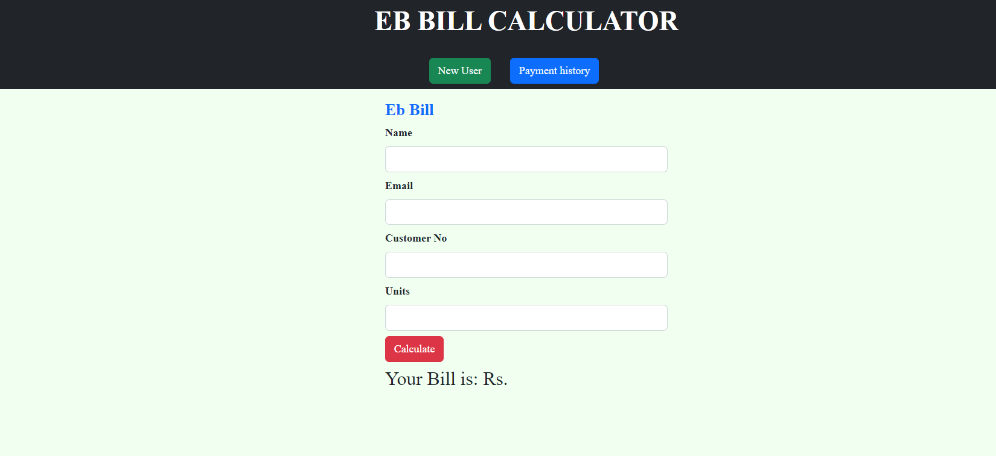
CALCULATING PAGE

Slide 4
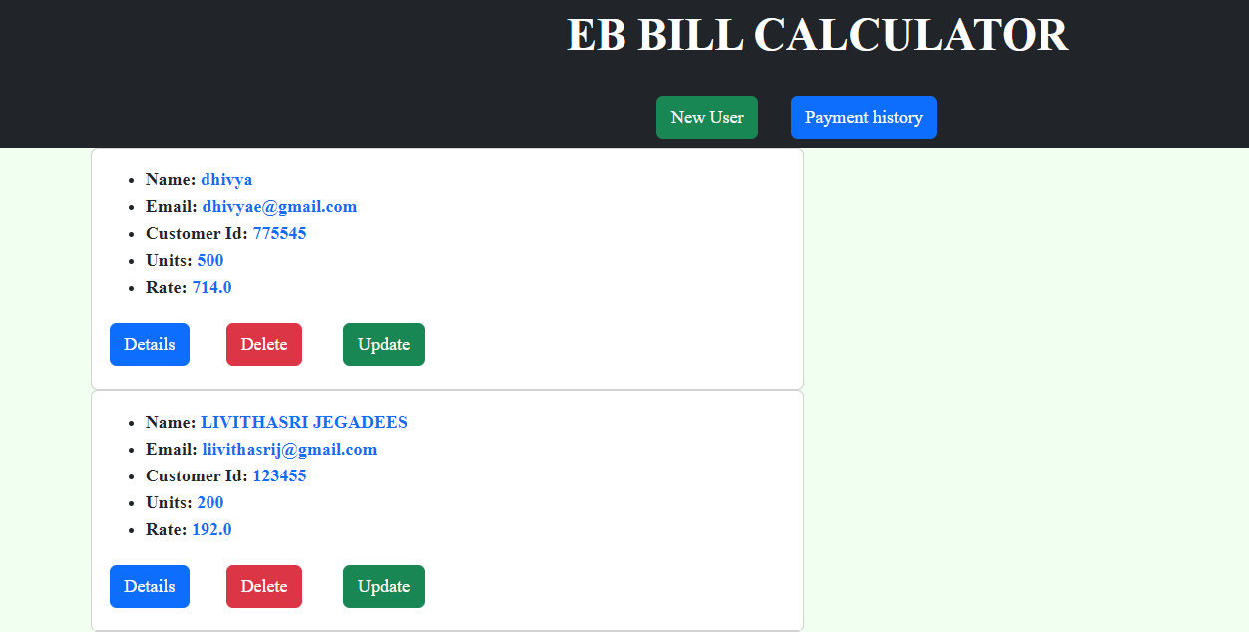
LIST OF USERS

Slide 5
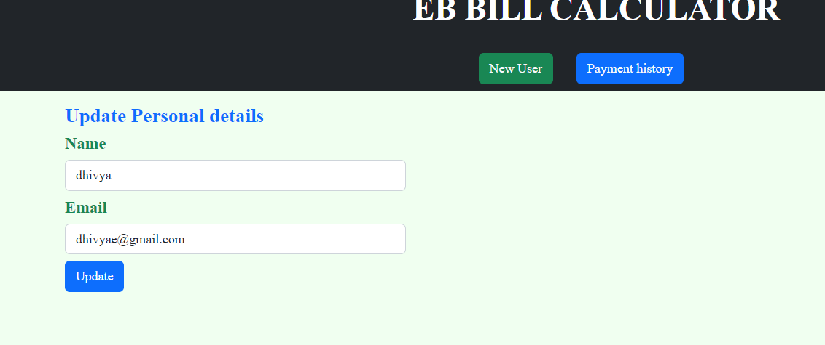
UPDATE USER DETAILS

Slide 6
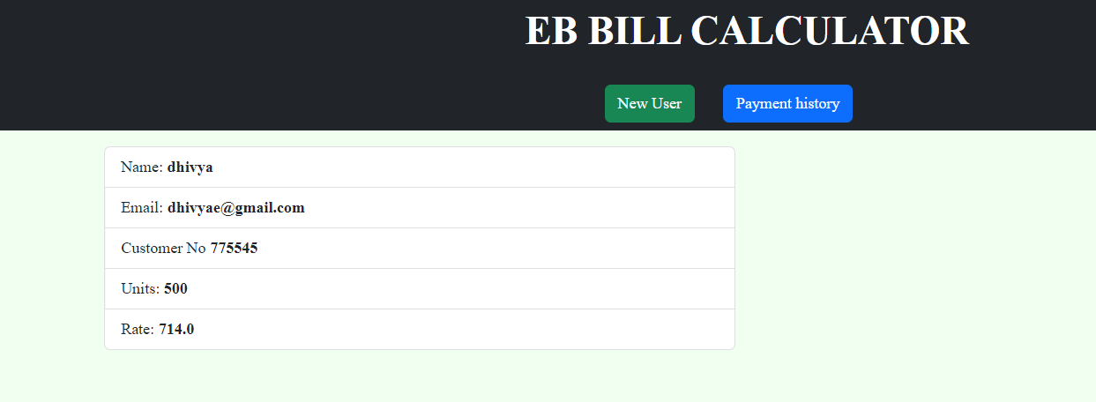
VIEW USERS PROFILE

Slide 7


